Slide 1

Contiguous Sequence Mining Approach for Program Procedure Pattern
Jian-Bin Liu Jing-Jing Zhao Li-Wei Zheng
School of Computer
Beijing Information Science and Technology University
第十七届全国软件与应用学术会议(NASAC 2018)，深圳

Slide 2
Software Reuse is important
Coding
Software component
Refactoring
Defect detection
program procedure pattern
程序过程模式
第十七届全国软件与应用学术会议(NASAC 2018)，深圳

Slide 3
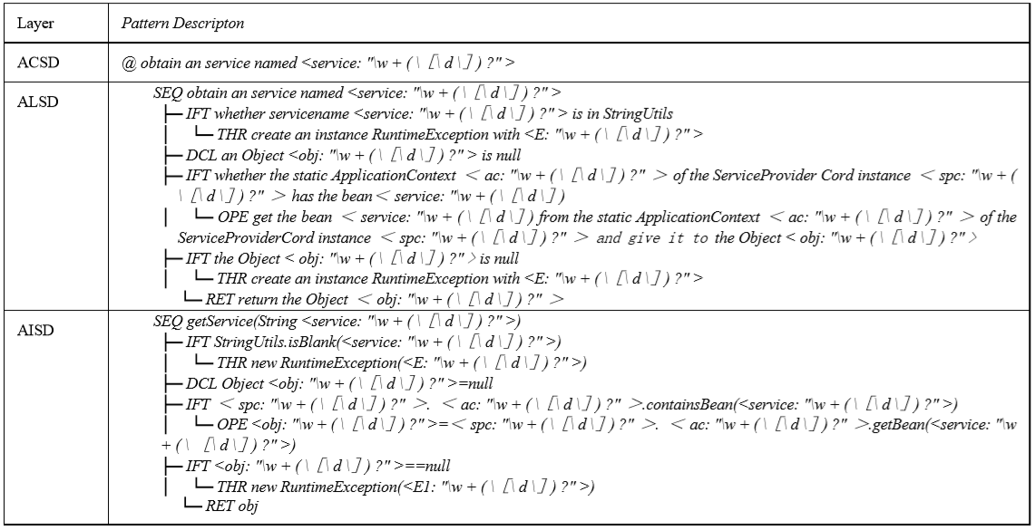
What is the program procedure pattern
The program procedure pattern abstracts reusable code fragments for data flow and control flow. It is based on the java process blueprint and has the three-layer view.
第十七届全国软件与应用学术会议(NASAC 2018)，深圳

Slide 4



Where is the program procedure pattern
The program procedure pattern is summarized from
the source code.
The main extraction method still stays in the stage of manual induction and summary.
Sources:
Big Code
……
第十七届全国软件与应用学术会议(NASAC 2018)，深圳

Slide 5
How to get the program procedure pattern
data mining technology
Program process logic
program procedure pattern
Sequence
Frequently appearing
A program procedure pattern discovery method based on contiguous sequence mining
第十七届全国软件与应用学术会议(NASAC 2018)，深圳
Notes:
the ppp is the description of the program process logic , it is the sequence, and it is frequentily appearing
So we use the contiguous sequence pattern mining to solve the problem.

Slide 6
Prepared Knowledge
Procedure Blueprint(过程蓝图)
A kind of program procedure representation model across the analysis, design and implementation phrases with the architecture of three abstract views at conceptual, logical and implementing level.
Abstract Implement Structure Diagram(AISD)(抽象实现结构图):
Implementing level | control flow and data flow.
第十七届全国软件与应用学术会议(NASAC 2018)，深圳

Slide 7
Prepared Knowledge
Program Structure Candidate Pattern (PSCP)（结构候选模式）
The combination of program structures which are ordered and frequently appearing
Program Structure Relation Candidate Pattern (PSRCP)（结构关系候选模式）
The code fragments mapped when the program structure and data flow features are frequently appearing.
第十七届全国软件与应用学术会议(NASAC 2018)，深圳

Slide 8
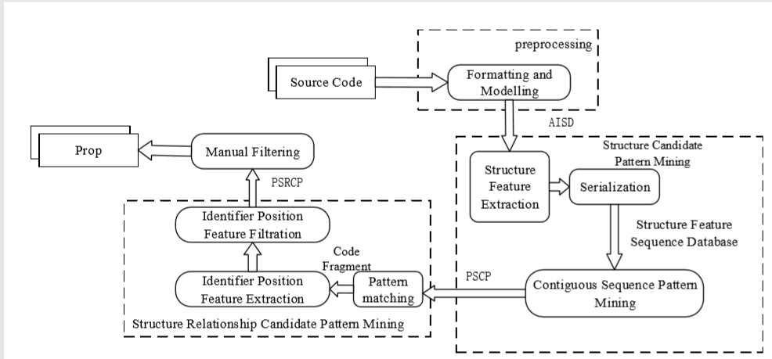
Contiguous Sequence Mining Process Model for Program Procedure Pattern
第十七届全国软件与应用学术会议(NASAC 2018)，深圳

Slide 9
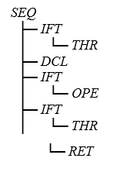
Structure Candidate Pattern Mining
program procedure pattern structure features
Program Control Feature(PCF)
Program Grammar Feature(PGF)
Class getService(String sername){
if(StringUtils.isBlank(sername)){
throw new RuntimeException(e);
}
Object obj = null;
if(spc.ac.containsBean(sername)){
obj = spc.ac.getBean(sername);
}
if(obj == null){
throw new RuntimeException(e);
}
return obj;
}
obj = spc.ac.getBean(sername);
VAR = VAR.VAR.getBean(VAR);
Structure feature sequence database
第十七届全国软件与应用学术会议(NASAC 2018)，深圳
Step 1: Establish the variable dictionary IdeDic to storage the variables.
Step 2: Model the source code to obtain the AISD and perform depth-first traversal in AISD to avoid losing the hierarchical relationships of source code.
Step 3: Get the control features and grammar features from AISD.
Step 4: Use a limited-length digital mapping method to encode the control features and use the ELFhash algorithm to encode grammar features and add them into database.

Slide 10
Structure Candidate Pattern Mining
Closed Contiguous Sequential pattern mining : CCSPAN
After the closed check, the candidate set may still contain redundant sequences.
The code fragment represented by the super sequence is more complete.
Maximal Contiguous Sequential pattern mining : MCSPAN
第十七届全国软件与应用学术会议(NASAC 2018)，深圳

Slide 11
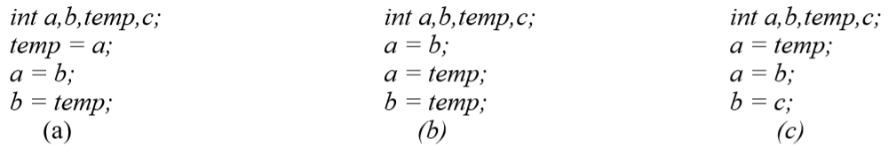
Structure Relation Candidate Pattern Mining
两数交换
一般代码
一般代码
The data flow feature can distinguish these programs with the same structure.
program procedure pattern identifier location feature
第十七届全国软件与应用学术会议(NASAC 2018)，深圳

Slide 12
Structure Relation Candidate Pattern Mining
Operands
identifier location feature
Equal
identifier location support
match each structure candidate pattern with AISD to obtain code fragment sets
traverse each code fragment to get the code-location set
find the fragments whose appearance frequency is greater than or equal to the identifier location support
第十七届全国软件与应用学术会议(NASAC 2018)，深圳

Slide 13
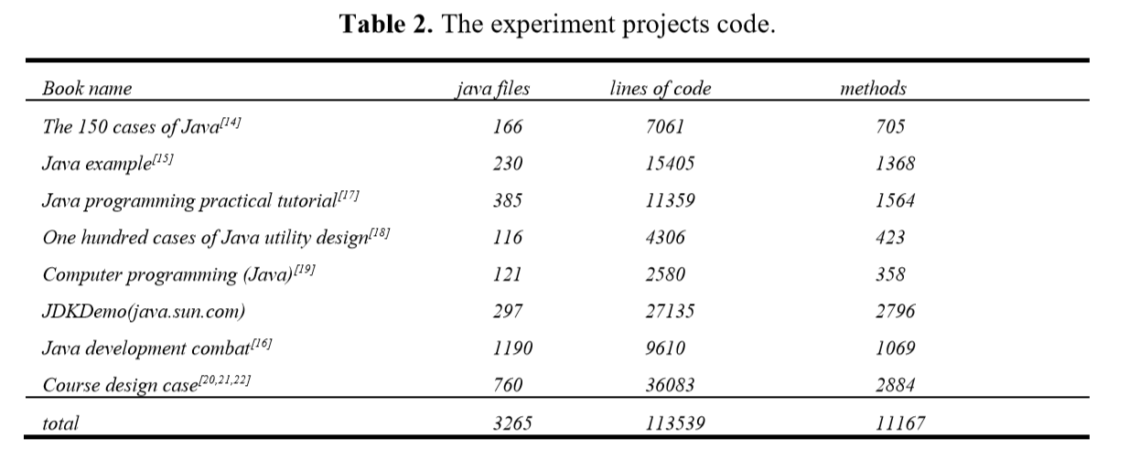
Experiment and Result Analysis
第十七届全国软件与应用学术会议(NASAC 2018)，深圳

Slide 14
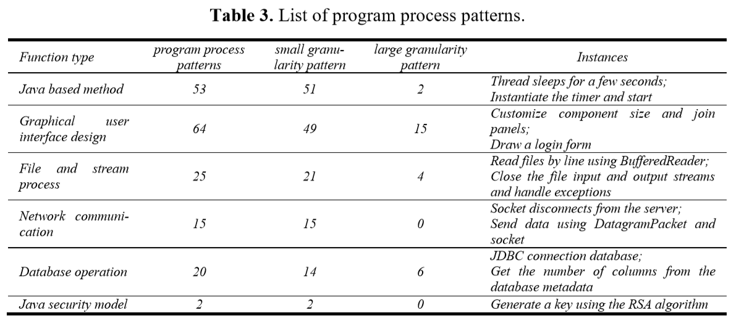
Analysis of Mining Results
第十七届全国软件与应用学术会议(NASAC 2018)，深圳

Slide 15
Analysis of Mining Results
Application range in project development or basic teaching
The usage flexibility of the corresponding APIs
The user's coding habits
第十七届全国软件与应用学术会议(NASAC 2018)，深圳
Notes:
The usage flexibility of the corresponding APIs

Slide 16
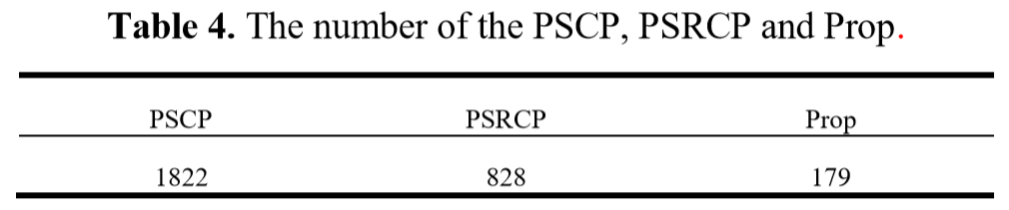
Analysis of Mining Results
The program identifier location feature plays an important role in filtering the program procedure patterns with saving time and effort.
第十七届全国软件与应用学术会议(NASAC 2018)，深圳

Slide 17
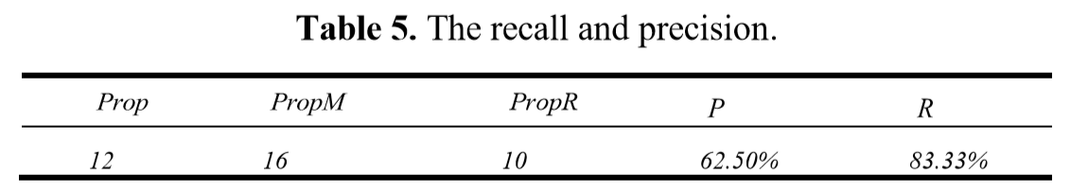


Evaluation of Experiment Results
The function semantic of some patterns are redundant, fuzzy and even incomplete.
The code of the same function is implemented in various ways, and some patterns cannot be directly represented.
The implementation of some functions is flexible in code execution order.
The same function can be realized by using different method names.
第十七届全国软件与应用学术会议(NASAC 2018)，深圳

Slide 18
Summary and Future Work
Present an effective method of mining program procedure patterns
Define and extract the program procedure features based on procedure blueprint
Apply the MCSPAN to source code mining
Focus on the variable definition declarations and calls
An incremental procedure pattern discovery algorithm should also be developed
Improve the recall and precision
第十七届全国软件与应用学术会议(NASAC 2018)，深圳

Slide 19
THANK YOU
Q&A?
第十七届全国软件与应用学术会议(NASAC 2018)，深圳

